Slide 1

SecureInfo Windows Software
University of kota
Department:- DEPARTMENT OF CSI
Summer Project By Prateek kumawat

Slide 2
About SecureInfo
Key Features
Benefits
System Requirement & Specification(SRS) Diagram
Data Flow Diagram(DFD)
Level 0
Level 1
Level 2
Methodology
Development Specification
User Interface(GUI) And Working
Login Page
Home Page
Information Menu
Conclusion
References
TABLE OF CONTENT​

Slide 3

Introduction
About SecoreInfo
SecureInfo is a understandable and user-friendly Software designed to encryption and decryption for security purpose.
It allows to encrypt and decrypt multiple Type of file/Information like that text, image, audio, video etc..
User can Encrypt and decrypt files in easily after register software.
Emphasize the focus on data security and encryption.

Slide 4
Introduction
Key Features
Encryption and Decryption: SecureInfo provides a simple and user-friendly interface that allows users to encrypt and decrypt various types of files and information.
Multiple File Types: The application supports encryption and decryption for a wide range of file formats, allowing you to protect different types of information according to your needs.
ECC key generate: SecureInfo provides ECC (Elliptic Curve Cryptography) Asymmetric Encryption Algorithm. This Algorithm is very secure and fast process then RSA and others.

Slide 5
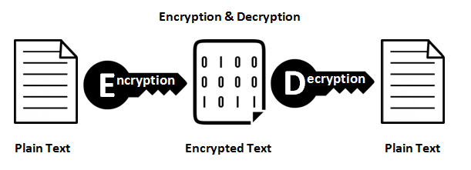
Encryption and Decryption
Encryption and decryption are two processes that help protect information
1. Encryption is the process of converting normal data (plaintext) into an unreadable form (ciphertext). Encryption is done by the sender of the data
2. Decryption is the process of converting the unreadable form (ciphertext) into its original form (plaintext). Decryption is done by the receiver of the data.

Slide 6

ECC (Elliptic Curve Cryptography)
Elliptic Curve Cryptography (ECC) is a public key encryption technique based on elliptic curve theory. It is used to create faster, smaller and more efficient cryptographic keys1. ECC focuses on pairs of public and private keys for decryption and encryption

Slide 7
Introduction
Benefits
Security of data: It will secure any kind of data like txt, pdf, image etc.
Hide data: We can hide txt data in image that will help to send confidential data.
Simple Interface: Interface of the application is very simple that mean anyone can use this software to encrypt there data.
Multi-functional Software: In this Software we have multiple option of encryption and decryption on multiple file type in one place that increase software efficiency.

Slide 8
Data Requirements
Functional Requirements
Files
Message
Text Encryption and Decryption
Image/Audio and Video Encryption and Decryption
PDF password protected
Text hide in Image
Ecc Encryption Algorithm use in all process
Software Requirements Specification (SRS)
Response Time
Scalability
Platform Dependencies
Fault Tolerance
RAM & STORAGE : 1Gb
OS: Any Windows OS
Access to In-Built Features: Gmail Sending
Performance Requirement

Slide 9
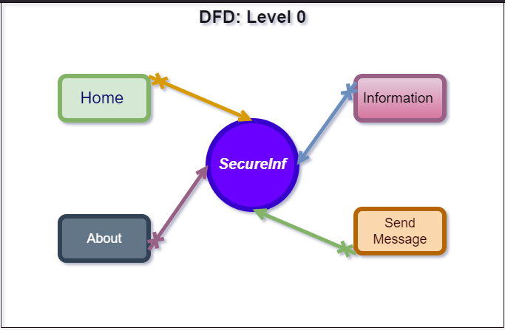
DATA FLOW DIAGRAM

Slide 10
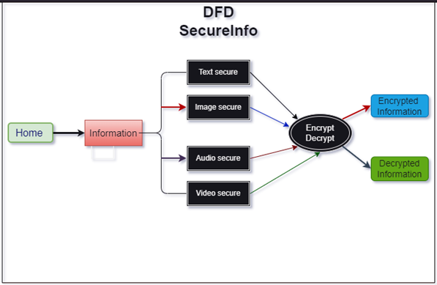
DATA FLOW DIAGRAM
: Level 1
Text secure
Image secure
Encrypted info
Encrypt & decrypt
Home
Information
Video secure
Decrypted info
Audio Secure

Slide 11
DATA FLOW DIAGRAM
DFD: Level2
secureInfo
Login/Reg.
Save & Retrieve
Cloud
Text secure
Encryption
Encrypted data
Image secure
Home
Information
Audio secure
Decryption
Decrypted data
Send Message
Video secure

Slide 12

Methodology

Slide 13
Specifications
Resources Specification
Front End: Using Tkinter
IDE: PyCharm Community
Back End: Python Language
OS: Window 10 pro
RAM: 8 GB
ROM: 512 GB
PROCESSOR: i5 7th Gen

Slide 14
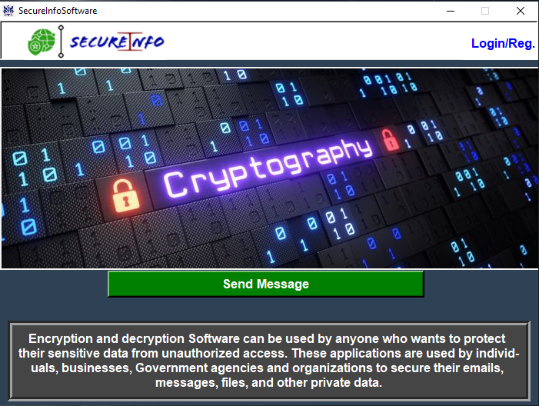
User Interface (GUI) And Working
Home Page:
In the home page there is basic overview of software and also a menu bar which contain some features of software also there is slidebar and also software logo.

Slide 15
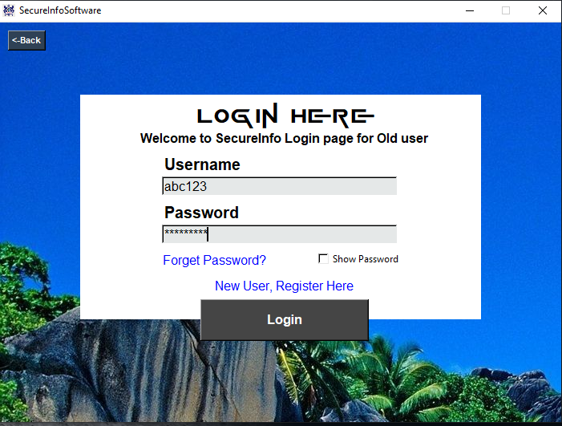
User Interface (GUI) & Working
Login & Register Page:
There is two pages Login and registration page which will contain user information for security purpose and login page will verify users by it’s login details.

Slide 16
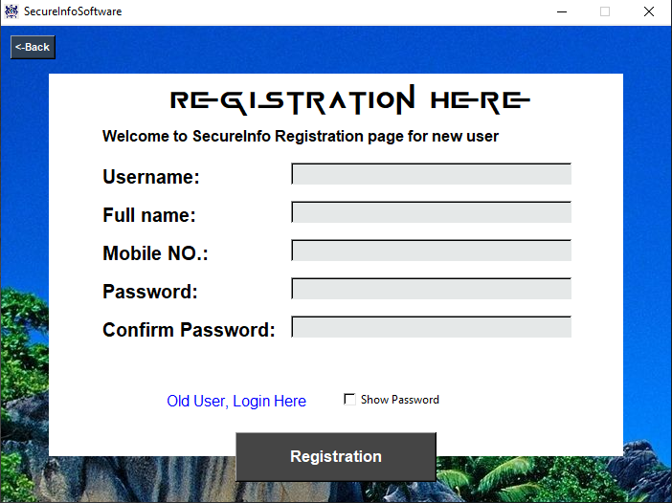
User Interface (GUI) & Working

Slide 17
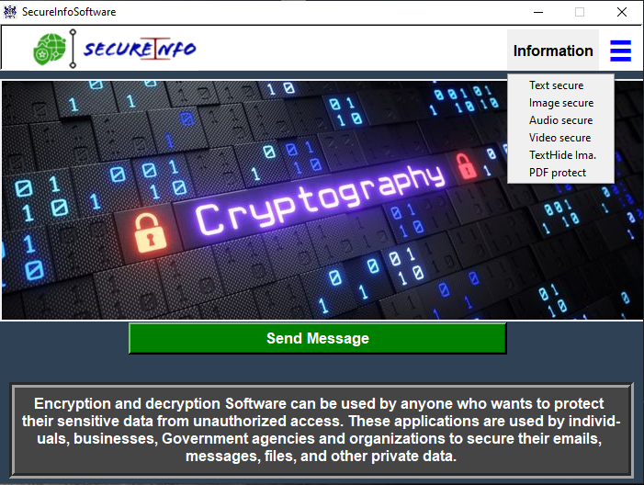
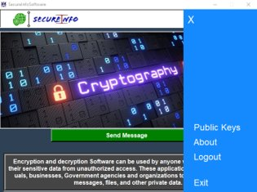
User Interface (GUI) & Working
Welcome
Prateek123
Information Menu:
Information Menu contain several Items which comes as features of software. Items like Text Secure, Image Secure, Video Secure, Audio Secure, Text HideImg and Pdf Protect.

Slide 18
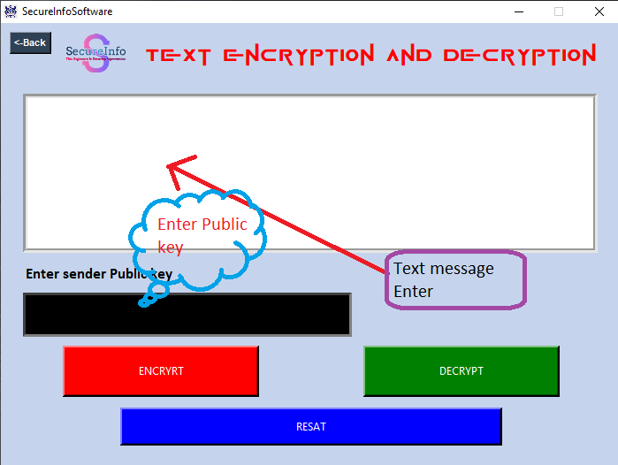
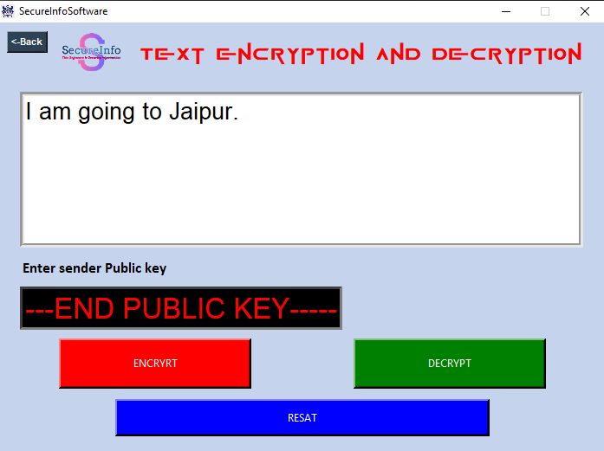
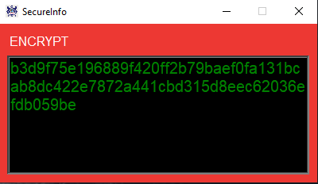
User Interface (GUI) & Working
Welcome
Prateek123

Slide 19
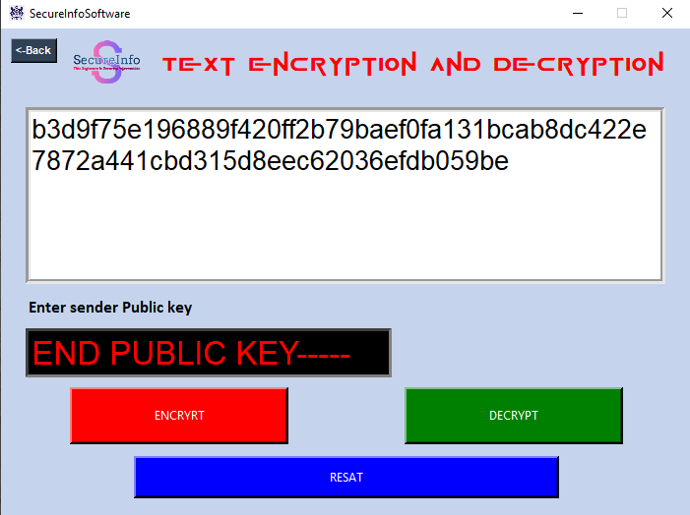
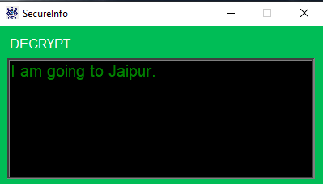
User Interface (GUI) & Working
Welcome
Prateek123

Slide 20
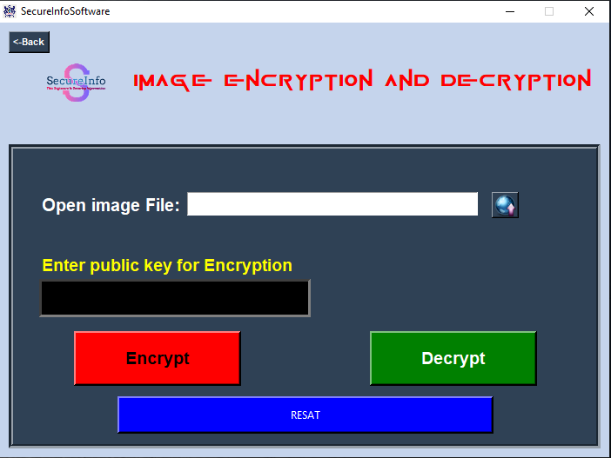
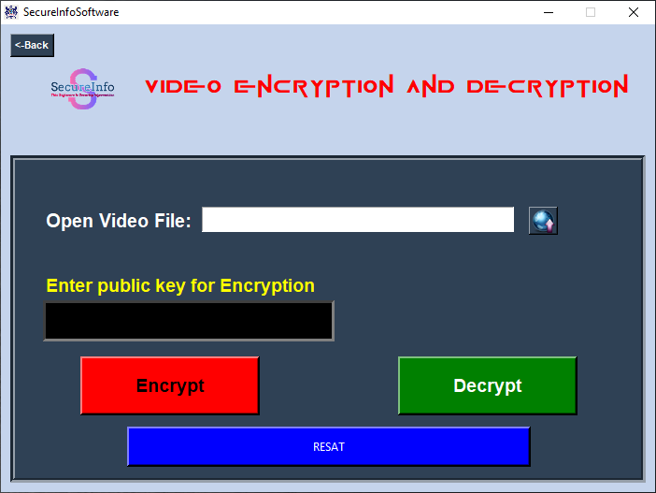
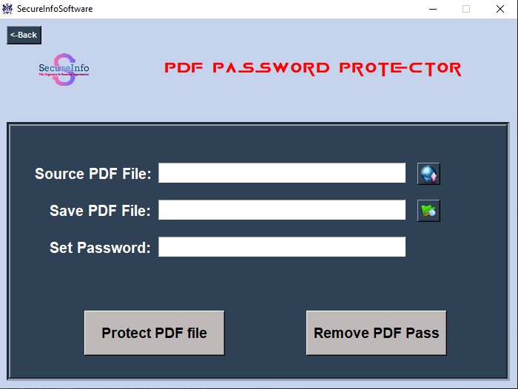
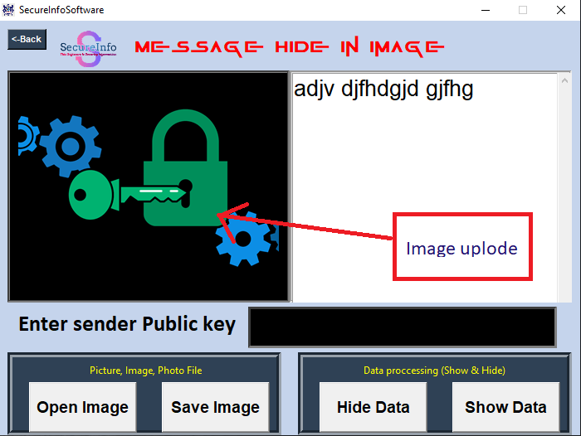
Welcome
Prateek123

Slide 21
Conclusion
Conclusion
SecureInfo protect confidential data by doing encryption and decryption and data like image, text, audio, video. SecureInfo also hide information in image that is also a great feature to hide confidential information. SecureInfo also provide a functionality to protect PDF which is a helpful tool to hide data of pdf from unwanted user. SecureInfo using a powerful ECC (Elliptic Curve Cryptography) algorithm for encryption and decryption.

Slide 22
References
Article on Types of Encryption: [Source: Prey Project] (https://rb.gy/c84h2)
YouTube Channels for Algorithm Learning Available:
[GateSmashers](https://www.youtube.com/@GateSmashers),
[5MinutesEngineering](https://www.youtube.com/@5MinutesEngineering),
[Rajeshwari Gundla](https://www.youtube.com/@rajeshwarigundla4038)
YouTube Channel for GUI Development : [CodeWithHarry](https://www.youtube.com/@CodeWithHarry)
Logo Creation: [Logo.com](https://logo.com/).
[Adobe Spark](https://www.adobe.com/express/create/logo)

Slide 23
THANK
YOU

